Slide 1



Futurion
Data Analysis
UPSKILLING INDIA
Portfoliio Project Challenge
Lung Cancer Prediction Analysis
01

Slide 2
Futurion
UPSKILLING INDIA
Project Title : Lung Cancer Prediction Analysis
Name : Asmit P. Patil
Date of Submission : 18-02-2025
Tools Used : (SQL + Power BI/Excel)
04

Slide 3
Futurion
UPSKILLING INDIA
Problem Statement & Objectives
Problem Statement
Lung cancer remains one of the leading causes of death worldwide.
The goal is to analyze key risk factors, such as smoking and air pollution, to predict lung cancer trends.
Identifying correlations between smoking, pollution, and cancer can aid in early detection and better treatment strategies.
Objectives
Predict lung cancer risk based on lifestyle and environmental factors.
Identify key trends in lung cancer prevalence.
Provide actionable insights for early detection and policy recommendations
05

Slide 4
Futurion
UPSKILLING INDIA
Dataset Overview
Dataset Summary
1. Source: Lung cancer dataset (MySQL)
2. Total Records: 220632
3. Key Columns: Age, Gender, Smoker, Years of Smoking, Lung Cancer Diagnosis, Air Pollution Exposure
Data Cleaning & Preprocessing Steps:
1. Replaced 0s with NULL values and Removed NULL values.
2. Standardized categorical data (e.g., "Yes" / "No" for binary fields).
3. Created new calculated columns where necessary (e.g., Risk Score for smoking impact)
Normalize or standardize relevant fields (e.g., age, blood counts).
06

Slide 5
Futurion
UPSKILLING INDIA
SQL Queries & Solutions
Question given in the task
-- Basic Level
-- 1. Retrieve all records for individuals diagnosed with lung cancer.
-- 2. Count the number of smokers and non-smokers.
-- 3. List all unique cancer stages present in the dataset.
-- 4. Retrieve the average number of cigarettes smoked per day by smokers.
-- 5. Count the number of people exposed to high air pollution.
-- 6. Find the top 5 countries with the highest lung cancer deaths.
-- 7. Count the number of people diagnosed with lung cancer by gender.
-- 8. Retrieve records of individuals older than 60 who are diagnosed with lung cancer.
-- Intermediate Level
-- 1. Find the percentage of smokers who developed lung cancer.
-- 2. Calculate the average survival years based on cancer stages.
-- 3. Count the number of lung cancer patients based on passive smoking.
-- 4. Find the country with the highest lung cancer prevalence rate.
-- 5. Identify the smoking years' impact on lung cancer.
-- 6. Determine the mortality rate for patients with and without early detection.
-- 7. Group the lung cancer prevalence rate by developed vs. developing countries.
-- Advanced Level
-- 1. Identify the correlation between lung cancer prevalence and air pollution levels.
-- 2. Find the average age of lung cancer patients for each country.
-- 3. Calculate the risk factor of lung cancer by smoker status, passive smoking, and family history.
-- 4. Rank countries based on their mortality rate.
-- 5. Determine if treatment type has a significant impact on survival years.
-- 6. Compare lung cancer prevalence in men vs. women across countries.
-- 7. Find how occupational exposure, smoking, and air pollution collectively impact lung cancer rates.
-- 8. Analyze the impact of early detection on survival years.
07

Slide 6
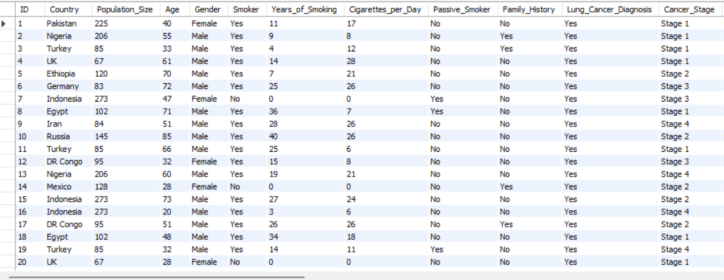
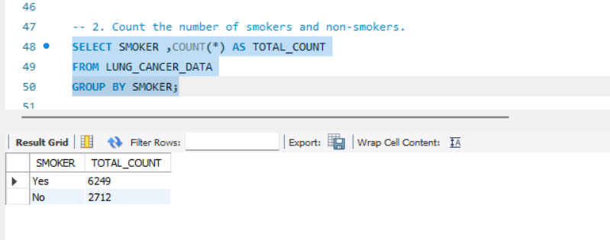
Futurion
Basic Level
--1. Retrieve all records for individuals diagnosed with lung cancer.
SELECT * FROM LUNG_CANCER_DATAWHERE LUNG_CANCER_DIAGNOSIS = 'yes’;
--2. Count the number of smokers and non-smokers.
.
UPSKILLING INDIA
07

Slide 7
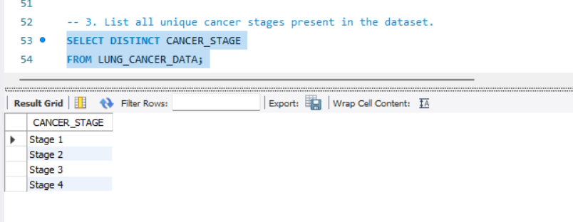
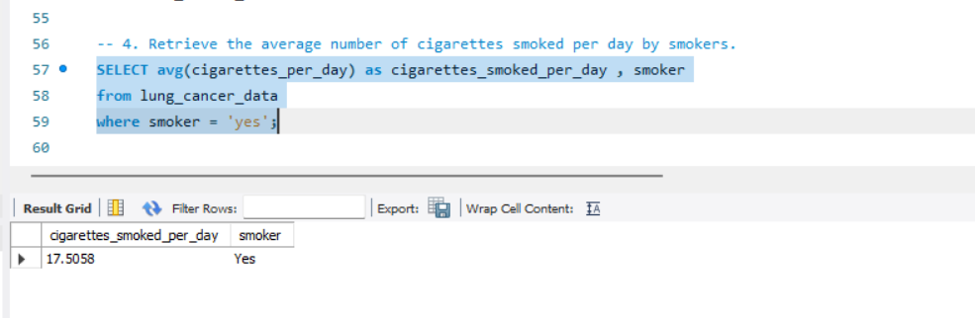
Futurion
UPSKILLING INDIA
--3. List all unique cancer stages present in the dataset.
SELECT DISTINCT CANCER_STAGEFROM LUNG_CANCER_DATA
This retrieves all unique values of cancer stages from the dataset
--4. Retrieve the average number of cigarettes smoked per day by smokers.
SELECT avg(cigarettes_per_day) as cigarettes_smoked_per_day , smoker
from lung_cancer_data
where smoker = 'yes’;
This calculates the average number of cigarettes smoked per day by smokers.
07

Slide 8
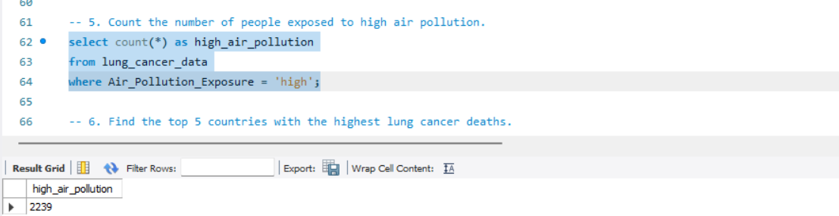
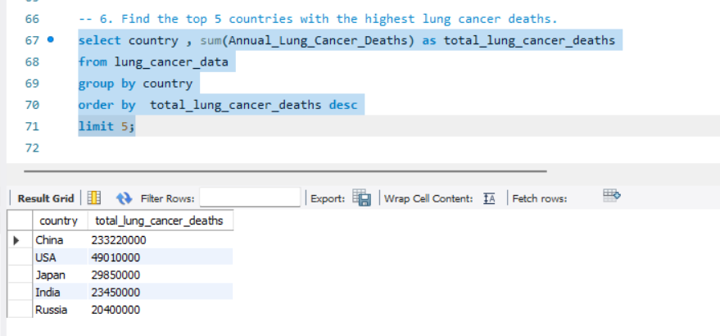
Futurion
UPSKILLING INDIA
5. Count the number of people exposed to high air pollution.
6. Find the top 5 countries with the highest lung cancer deaths.
06

Slide 9
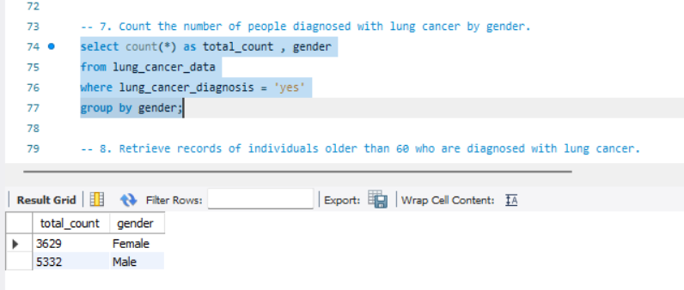
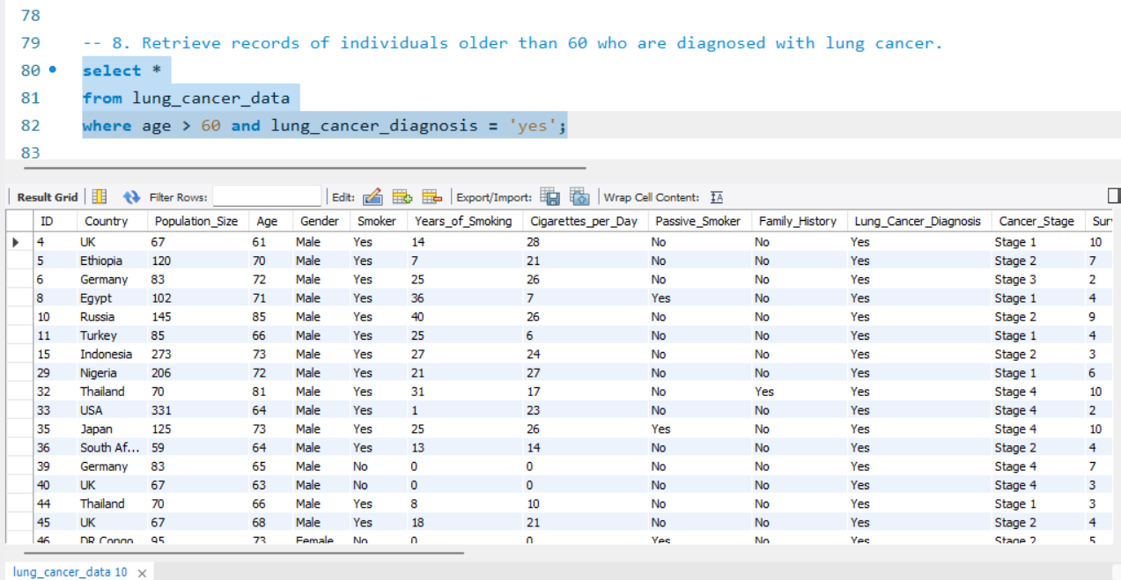
Futurion
UPSKILLING INDIA
7. Count the number of people diagnosed with lung cancer by gender.
8. Retrieve records of individuals older than 60 who are diagnosed with lung cancer.
06

Slide 10
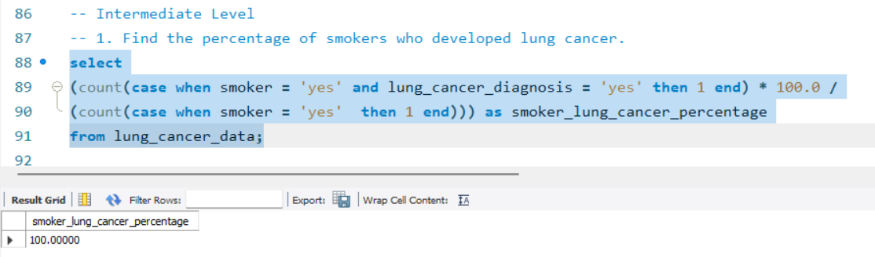
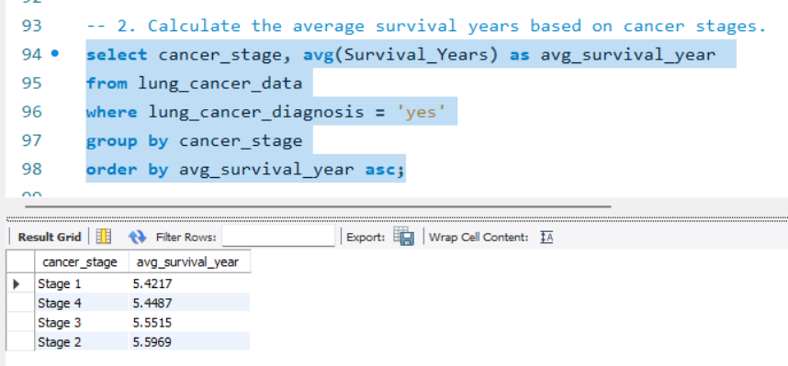
Futurion
UPSKILLING INDIA
Intermediate Level
-- 1. Find the percentage of smokers who developed lung cancer.
--2. Calculate the average survival years based on cancer stages.
06

Slide 11
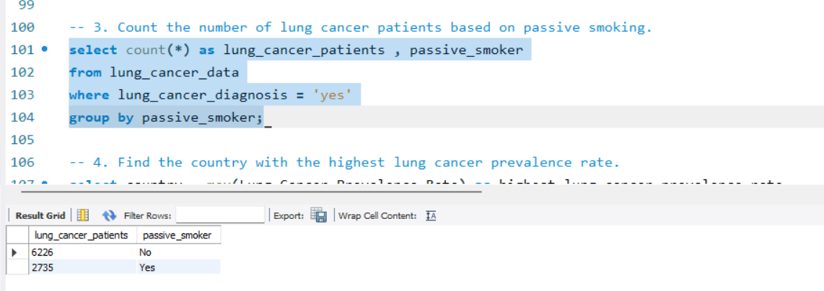
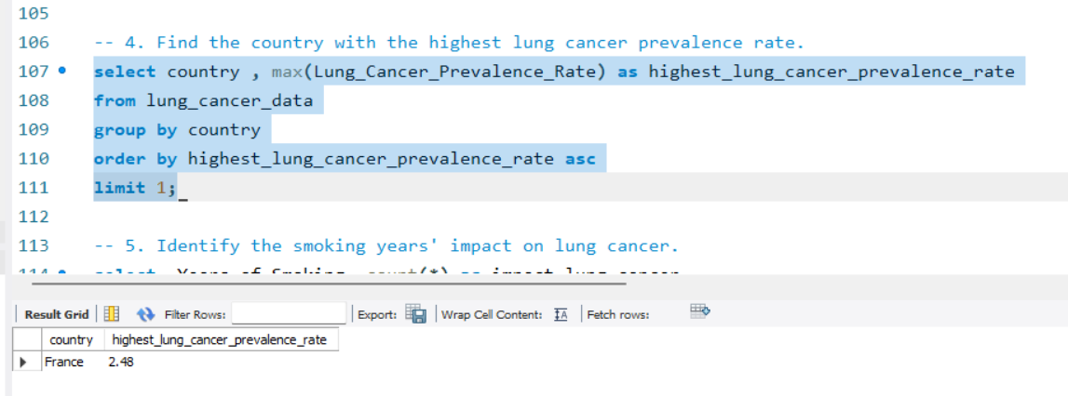
Futurion
-3. Count the number of lung cancer patients based on passive smoking.
--4. Find the country with the highest lung cancer prevalence rate.
UPSKILLING INDIA
Normalize or standardize relevant fields (e.g., age, blood counts).
06

Slide 12
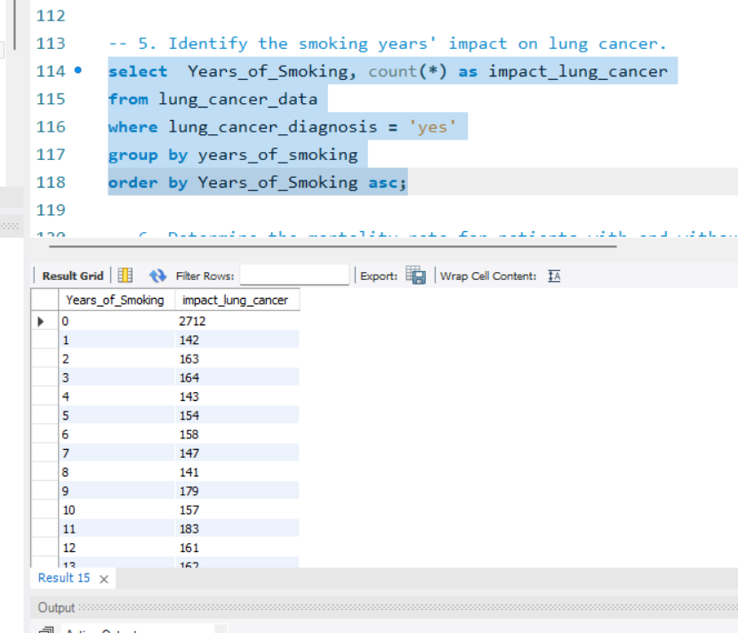
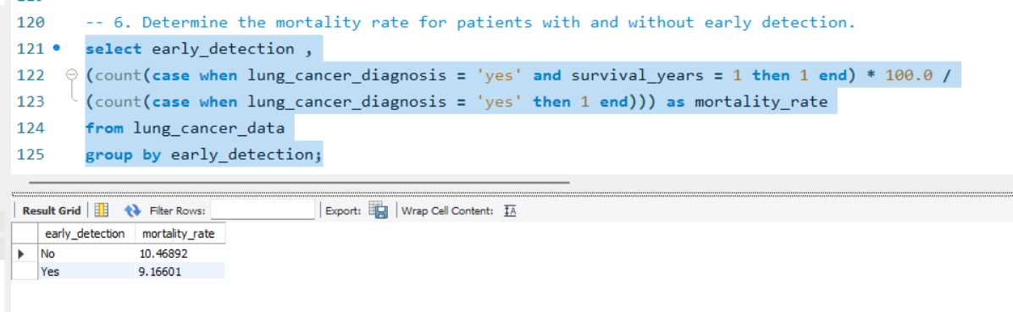
Futurion
UPSKILLING INDIA
--5. Identify the smoking years' impact on lung cancer.
--6. Determine the mortality rate for patients with and without early detection.
Normalize or standardize relevant fields (e.g., age, blood counts).
06

Slide 13
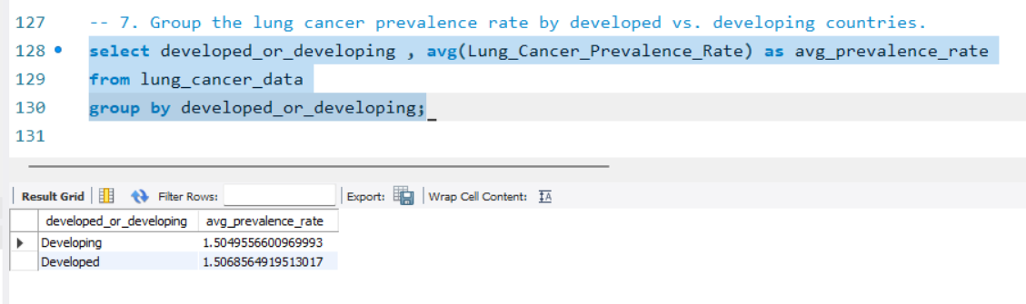
Futurion
UPSKILLING INDIA
--7. Group the lung cancer prevalence rate by developed vs. developing countries.
select developed_or_developing , avg(Lung_Cancer_Prevalence_Rate) as avg_prevalence_rate
from lung_cancer_data
group by developed_or_developing
Normalize or standardize relevant fields (e.g., age, blood counts).
06

Slide 14
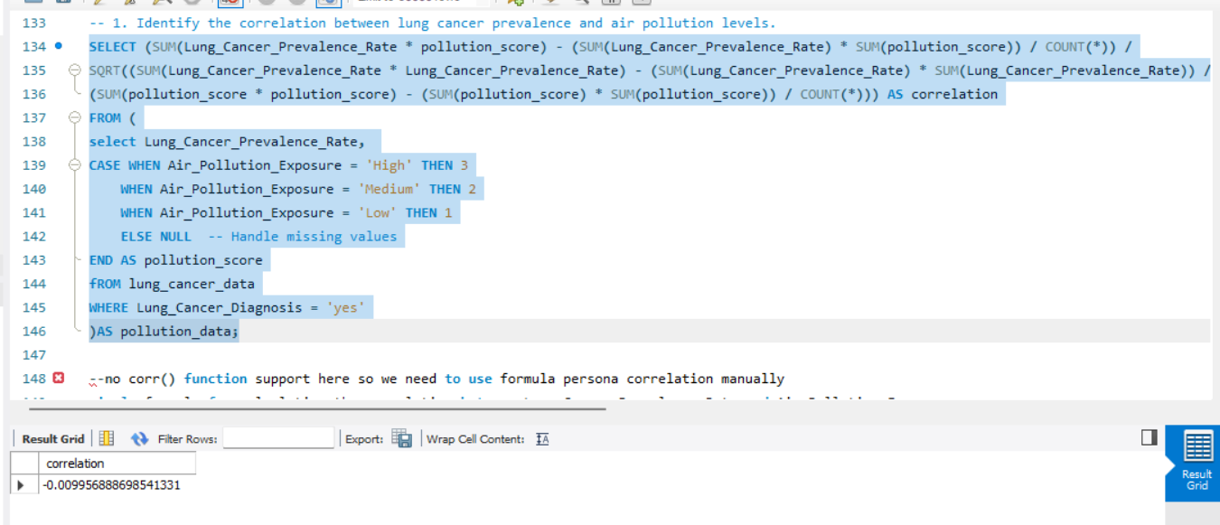
Futurion
UPSKILLING INDIA
Advanced Level
-- 1. Identify the correlation between lung cancer prevalence and air pollution levels.
Normalize or standardize relevant fields (e.g., age, blood counts).
06

Slide 15
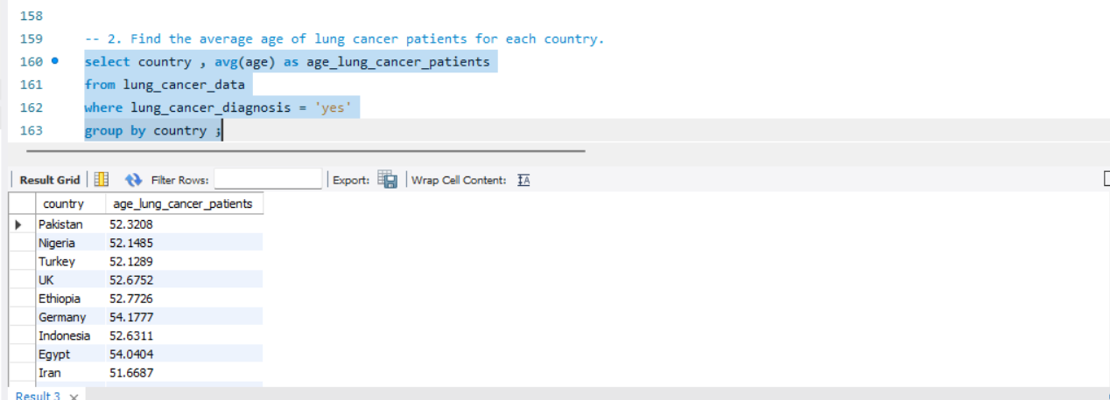
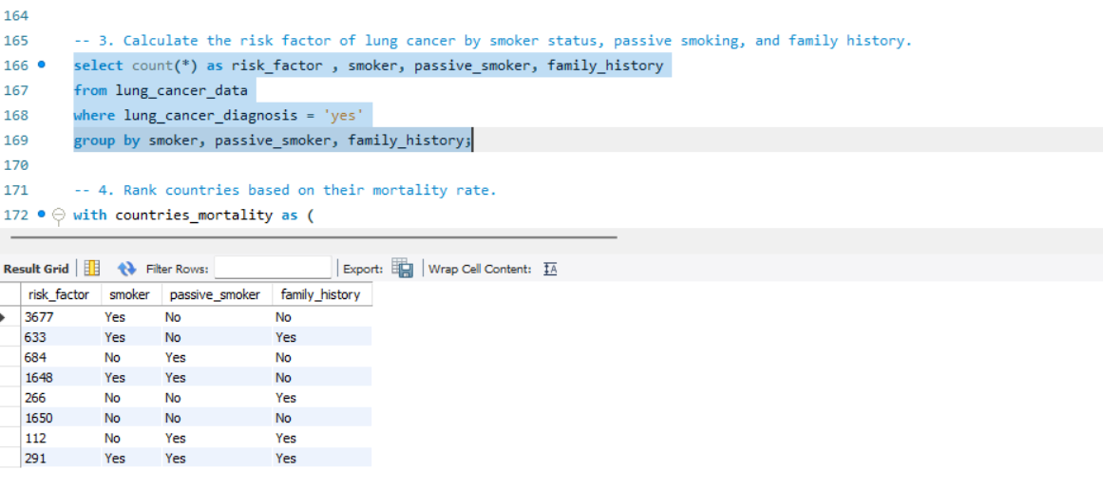
Futurion
UPSKILLING INDIA
--2. Find the average age of lung cancer patients for each country
- 3. Calculate the risk factor of lung cancer by smoker status, passive smoking, and family history.
Normalize or standardize relevant fields (e.g., age, blood counts).
06

Slide 16
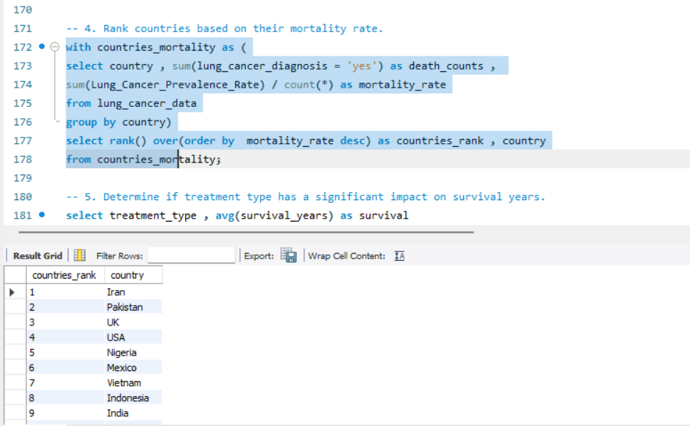
Futurion
UPSKILLING INDIA
-- 4. Rank countries based on their mortality rate.
Normalize or standardize relevant fields (e.g., age, blood counts).
06

Slide 17
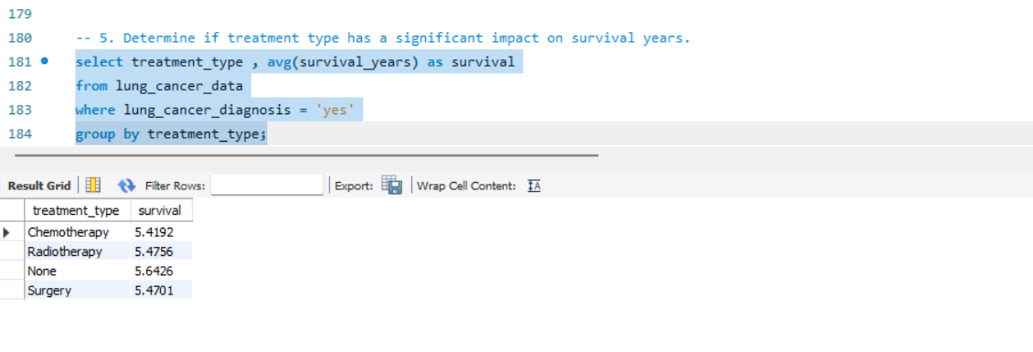
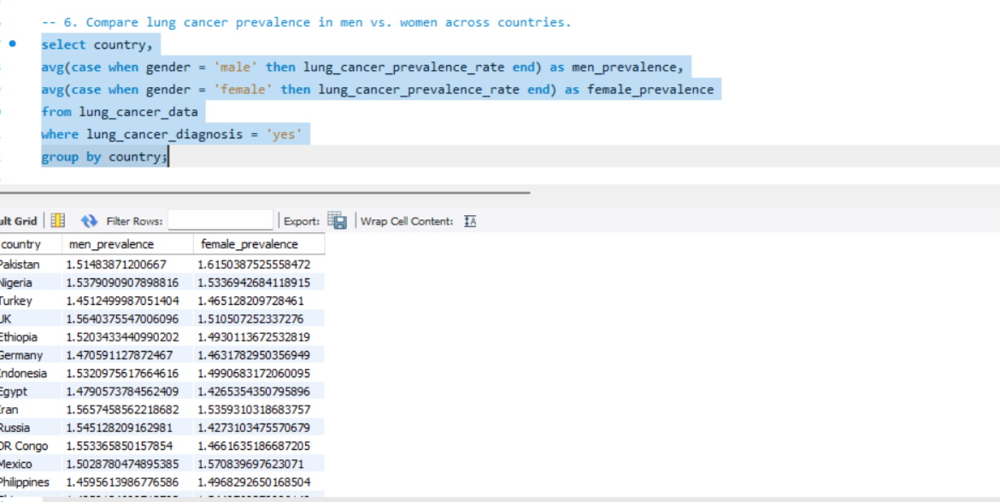
Futurion
UPSKILLING INDIA
--5. Determine if treatment type has a significant impact on survival years.
-- 6. Compare lung cancer prevalence in men vs. women across countries.
Normalize or standardize relevant fields (e.g., age, blood counts).
06

Slide 18
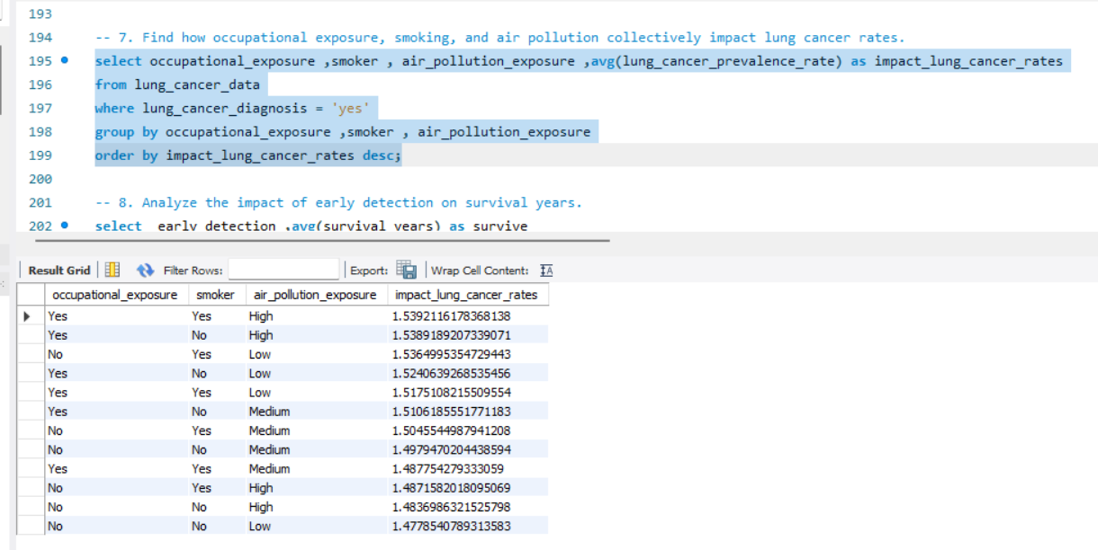
Futurion
UPSKILLING INDIA
-- 7. Find how occupational exposure, smoking, and air pollution collectively impact lung cancer rates.
Normalize or standardize relevant fields (e.g., age, blood counts).
06

Slide 19
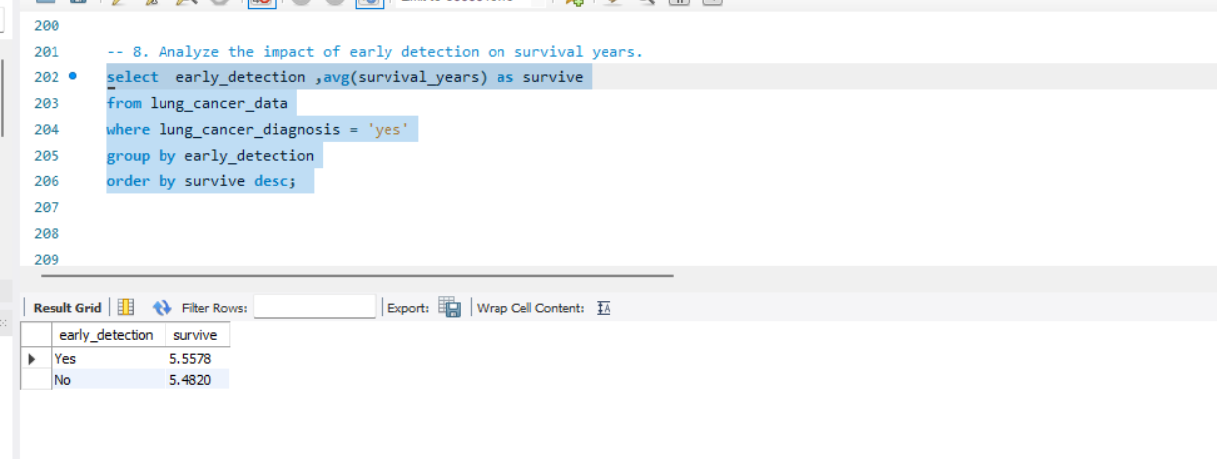
Futurion
UPSKILLING INDIA
-- 8. Analyze the impact of early detection on survival years.
Normalize or standardize relevant fields (e.g., age, blood counts).
06

Slide 20
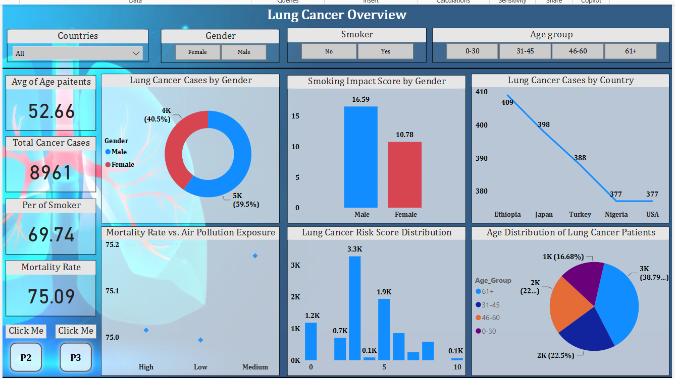
Futurion
UPSKILLING INDIA
Data Visualization & Dashboard
Dashboard 1
Normalize or standardize relevant fields (e.g., age, blood counts).
06

Slide 21
Futurion
Key Insights
Key Visuals Used
Lung Cancer Cases by Country
Highlights regional lung cancer prevalence.
Lung Cancer Cases by Gender
Shows the distribution of cancer cases across genders.
Age Distribution of Lung Cancer Patients
Groups age ranges for better analysis.
Smoking Impact Score by Gender
Compares smoking severity between genders.
Mortality Rate vs. Air Pollution Exposure
Analyzes environmental impact on lung cancer mortality.
Lung Cancer Risk Score Distribution
Filters data for deeper analysis.
UPSKILLING INDIA
07

Slide 22
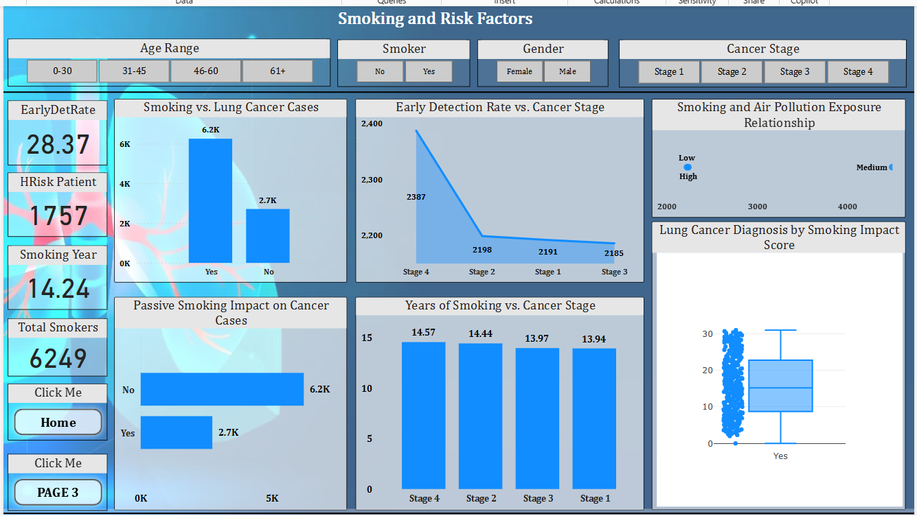
Futurion
Dashboard 2
UPSKILLING INDIA
07

Slide 23
Futurion
Key Insights
Key Visuals Used
1. Smoking vs. Lung Cancer Cases
To analyze the relationship between smoking status (Smoker vs. Non-Smoker) and lung cancer diagnosis.
2. Years of Smoking vs. Cancer Stage
To analyze if longer smoking duration correlates with more severe cancer stages.
3. Passive Smoking Impact on Cancer Cases
To compare lung cancer cases among individuals exposed and not exposed to passive smoking.
4. Smoking and Air Pollution Relationship
To determine if high air pollution levels and smoking together increase lung cancer prevalence.
UPSKILLING INDIA
07

Slide 24
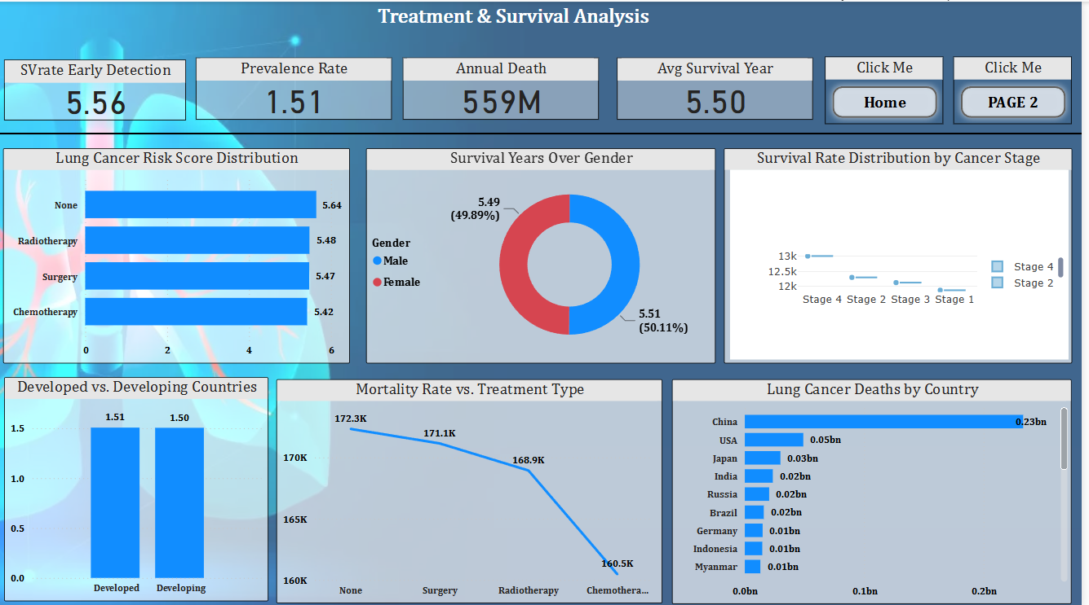
Futurion
Dashboard 3
UPSKILLING INDIA
07

Slide 25
Futurion
Key Insights
Key Visuals Used
Survival Years by Treatment Type
To compare survival years across different treatment types and identify which treatment leads to longer survival.
2. Lung Cancer Deaths by Country
To visualize lung cancer mortality rates across different countries.
3. Developed vs. Developing Countries: Cancer Prevalence
To compare lung cancer prevalence rates between developed and developing countries.
4. Survival Rate Distribution by Cancer Stage
To analyze how survival years are distributed across different lung cancer stages.
UPSKILLING INDIA
07

Slide 26
Futurion
UPSKILLING INDIA
Conclusion & Business Recommendations
Key Findings:
High smoking rates correlate with increased lung cancer cases.Early detection significantly improves survival rates.Air pollution exposure impacts lung cancer mortality.
Recommendations:
✔️ Promote smoking cessation programs.
✔️ Increase early screening & awareness campaigns.
✔️ Improve air quality policies in high-risk areas.
Normalize or standardize relevant fields (e.g., age, blood counts).
06

Slide 27
Futurion
References & Acknowledgments
Data Source: Lung Cancer Dataset (SQL + Power BI)
Tools Used: MySQL, Power BI, DAX
Contributors: Asmit Patil
UPSKILLING INDIA
07

